Slide 1
MEDICAL AUDIT
ADUIT CYCLE
TYPES

Slide 2
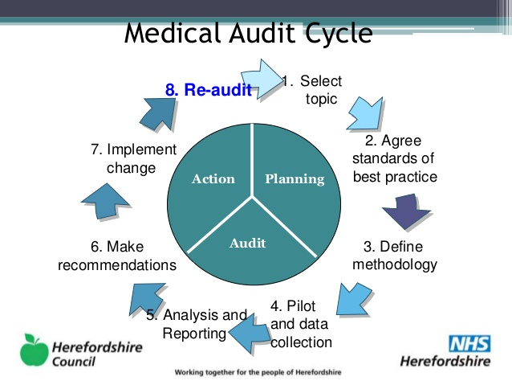

Slide 3
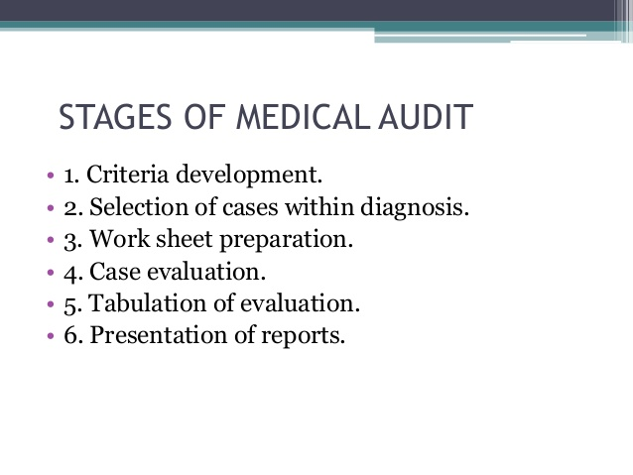

Slide 4
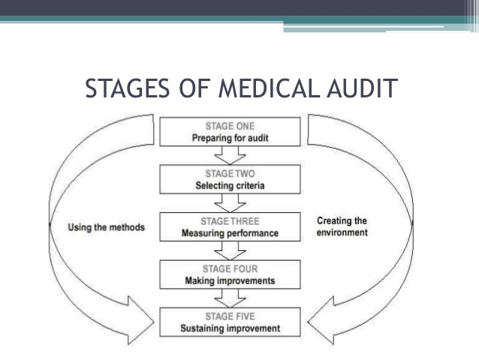

Slide 5
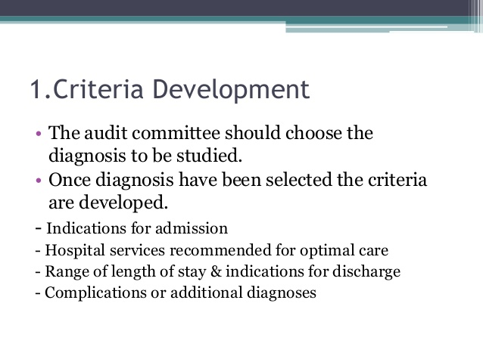

Slide 6
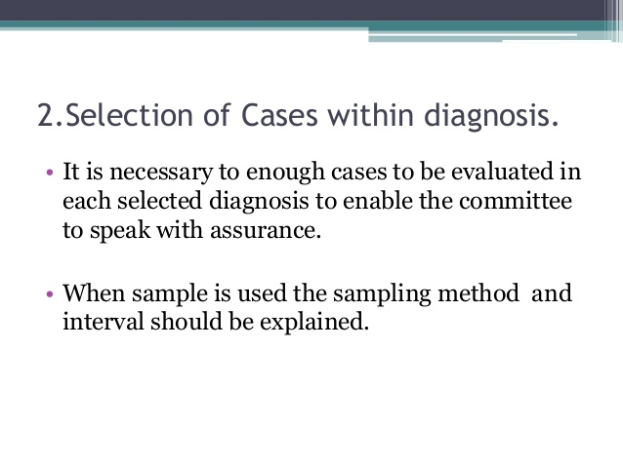

Slide 7
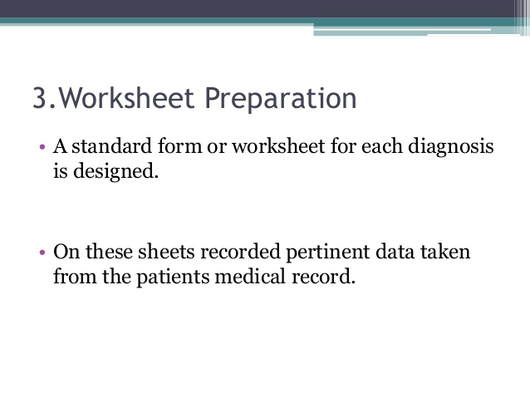

Slide 8
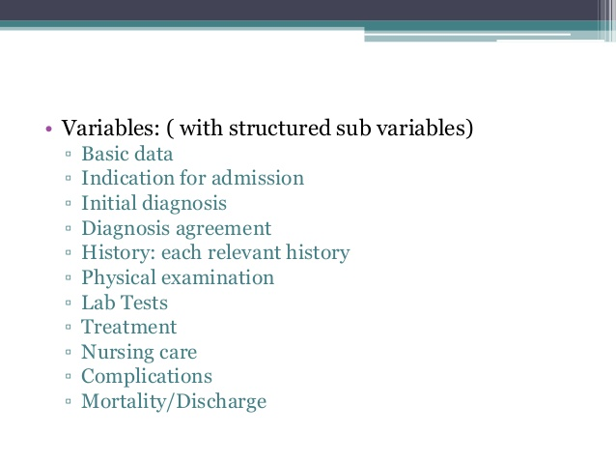

Slide 9
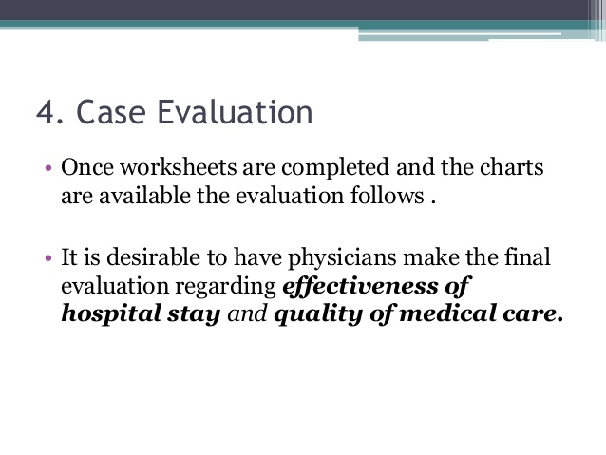

Slide 10
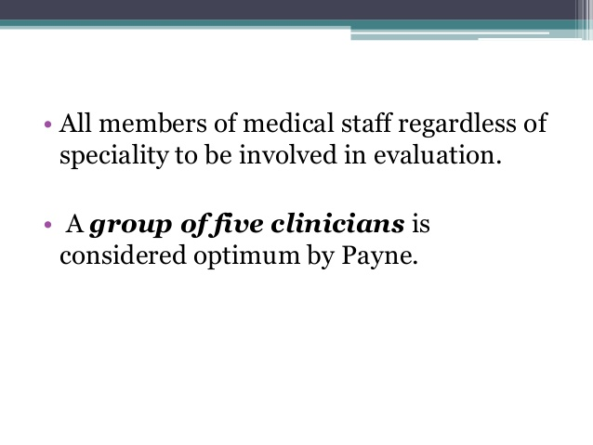

Slide 11
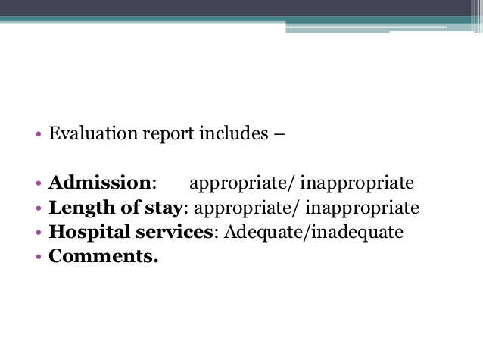

Slide 12
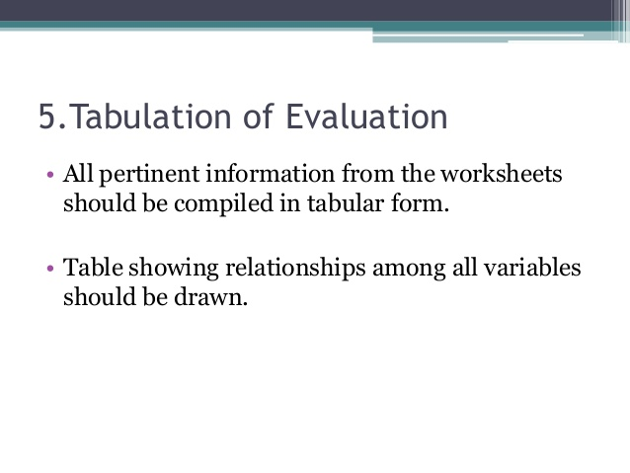

Slide 13
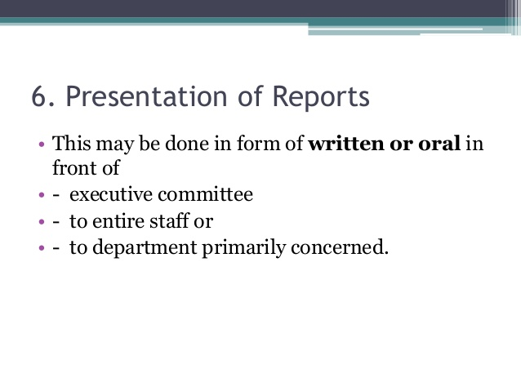

Slide 14
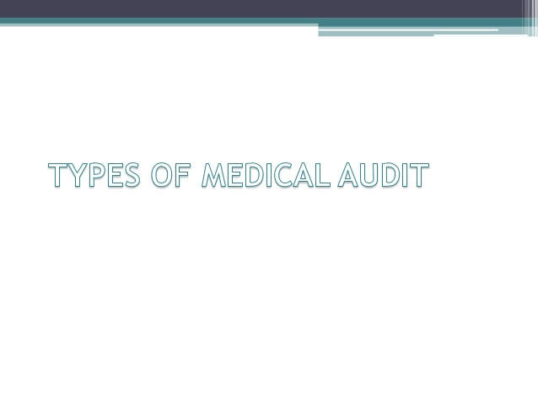

Slide 15
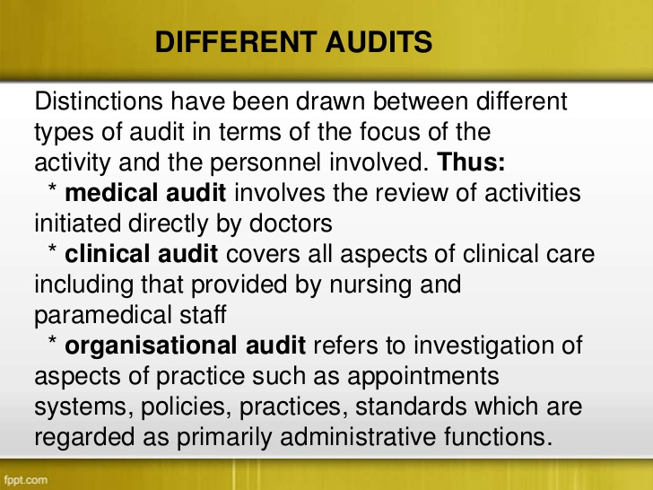
DIFFERENT AUDITS

Slide 16
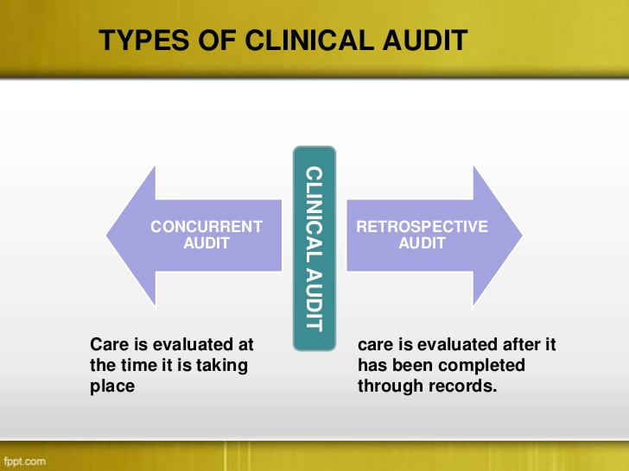
TYPES OF CLINICAL AUDIT

Slide 17
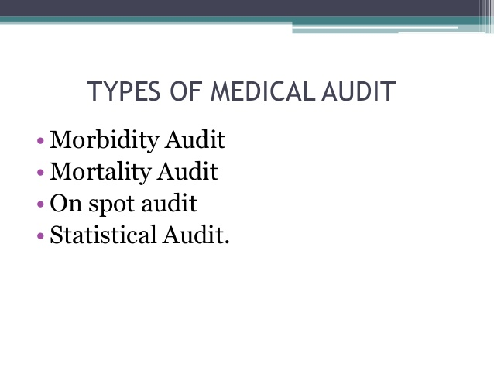

Slide 18
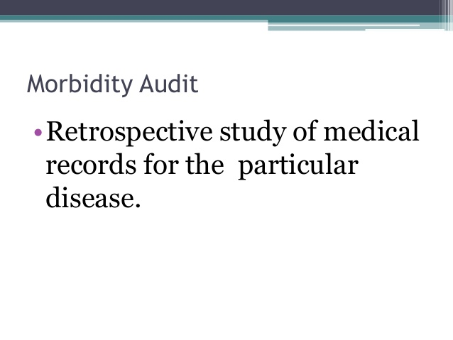

Slide 19
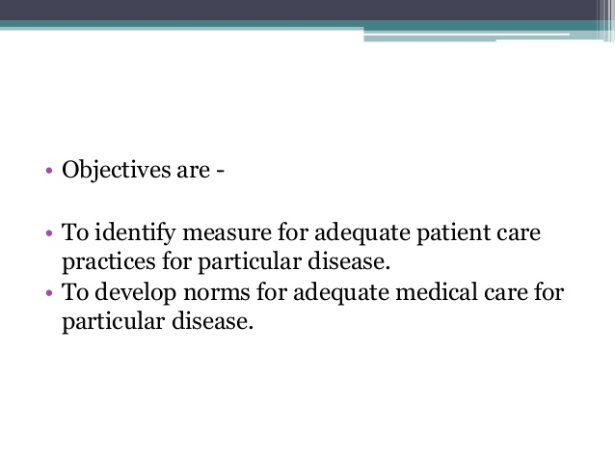

Slide 20
USES
These data are increasingly being used in the formulation of health policies and Programs and in th(eir management , monitoring and evaluation.
In epidemiology in identification of risk population.
In clinical research( including studies of disease occurrence in different socio-economic groups )

Slide 21
What is morbidity audit ?
The main condition is defined as the condition, diagnosed at the end of the episode of health care, primarily responsible for the patient’s need for the treatment or investigation.
If there is more than one such condition, the one held most responsible for the greatest use of resources should be selected.
If no diagnosis was made, the main symptom, abnormal finding or problem should be selected as the main condition.
The other conditions are defined as those conditions that coexist or develop during the episode of health care and affect the management of the patient. Conditions related to an earlier episode that have no bearing on the current episode should not be recorded.
w

Slide 22
Guidelines on recording the diagnostic information for single condition analysis of morbidity data :
The health care provider responsible for the patient’s treatment should select the main condition to be recorded , as well as any other condition, for each episode of health care.
This information should be organised systematically by using standard recording methods
A properly complete record is essential for good patient management and is valuable source of epidemiological and other statistical data on morbidity and other health care problems.

Slide 23
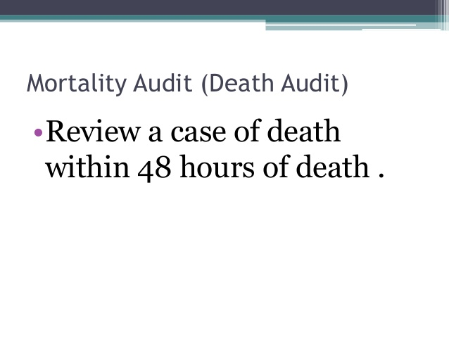

Slide 24
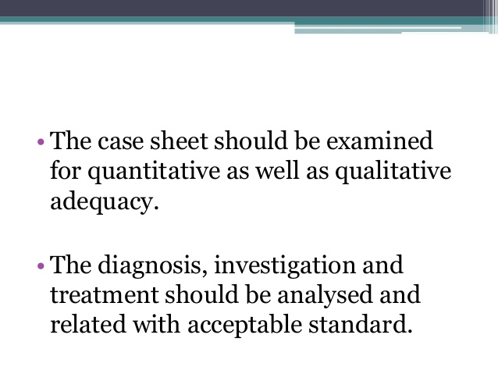

Slide 25
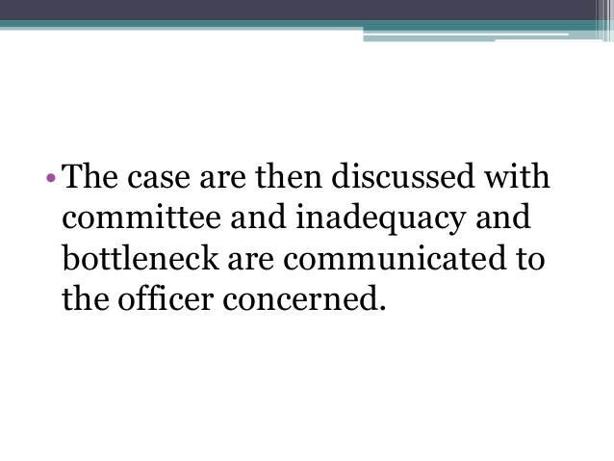

Slide 26
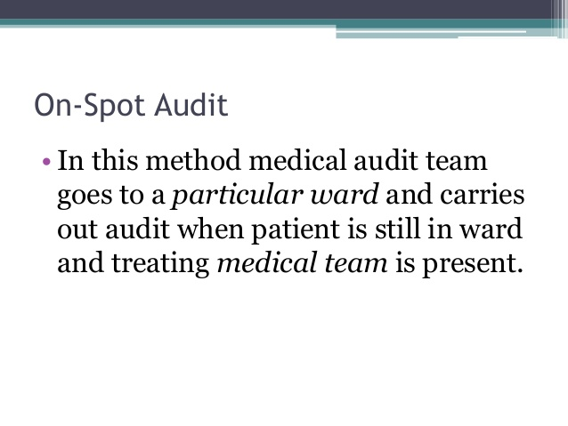

Slide 27
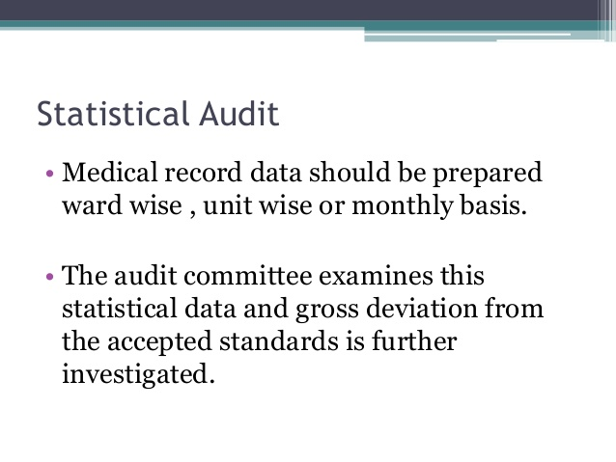

Slide 28
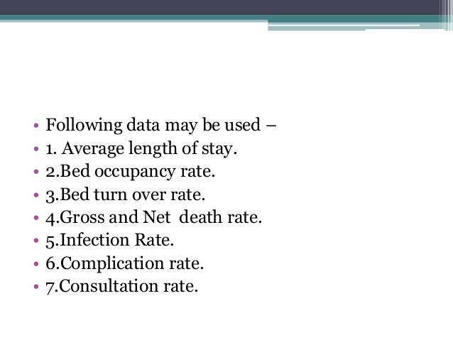

Slide 29
METHODS OF MEDICAL AUDITING
There are two phases of medical auditing .
First phase includes the quantitative aspects by way of providing adequate records of performance as a basis of analysis .
The second phase of medical audit is the qualitative aspects ,that is actual analysis of recorded data in the clinical records, the filled reports pertaining to the professional work of the hospital and other related information .
The auditing of quantitative and qualitative analysis can be performed by two ways :
1.INTERNAL
2.EXTERNAL

Slide 30
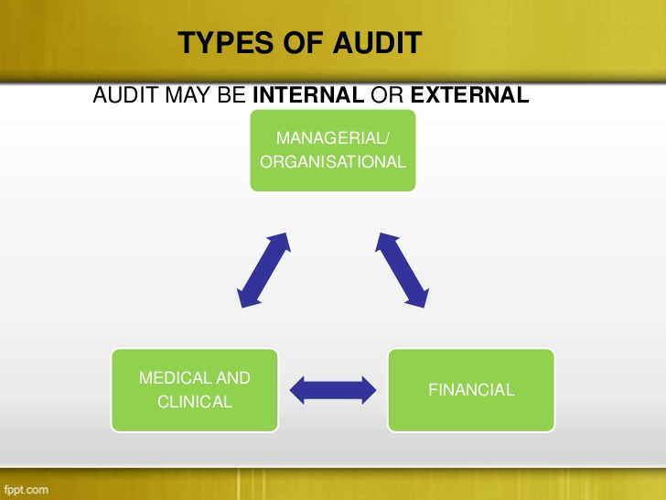
METHODS OF MEDICAL AUDIT

Slide 31
INTERNAL AUDIT
The qualititative aspects of medical auditing can be done by the staff of medical records department.
All the records of patients discharged can be collected daily and arranged in a standard chronological order, then the deficiencies of each discharged record is listed in the deficiency slip.
This is to enable the doctors to complete during the weekly doctor’s confertence / mrd room.
The qualititative aspects of medical auditing can be done only by medical personnel who are specialized in the field.
To have a countercheck, the medical officers of other unit belonging to the same service can be asked to verify the papers of patient records and give their opinion , whether the treatment carried out was consistent with complaints, diagnosis of patient or not .
If they differ, they submit their remarks to the treating doctor.
Periodical counter checking of different units of same service is possible only when the heads of various units agree to co-operate in achieving the object of rendering best possible available medical care to patient

Slide 32
External audit
External audit denotes , the work of treating doctor and is done by the members other than the treating team of doctors.
The following are some of the ways for conducting external audit .
1. Hospital administrator with the assistance of few selected clinicians can undertake the medical audit work by conducting monthly medical statistical meeting in the 1st or 2nd week to discuss the hospital statistics for the previous month, this random check every month by the administration and clinician can keep a check on clinician’s work.
2.Medical audit committee can be formed in each hospital with five to ten physicians/surgeons of good judgement, frank, fearless and without prejudices, well skilled
3. The Director of medical and Health Services can select few specialized physicians/surgeons for the purpose, they can make periodical visits to the hospital to examine the professional work and make confidential report to medical superintendent

Slide 33
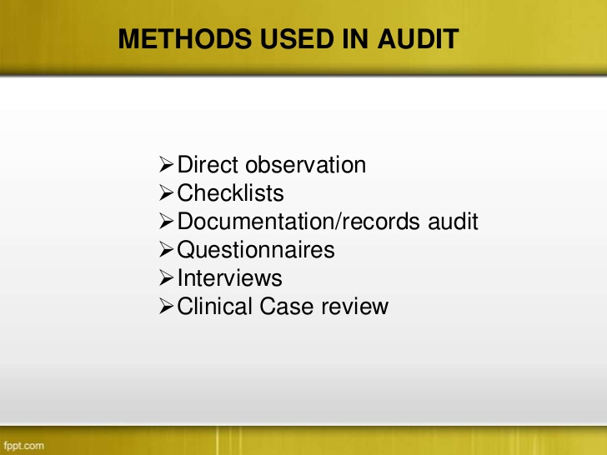
DIFFERENT METHODS USED IN AUDIT

Slide 34
Commonly found deficiencies in audit
1.Diagnosis without complete description, improper terminology
2. detailed diagnosis is written inside bit not on the face sheet
3. Different final diagnosis recorded on the face sheet and discharge summary .
4. Discharge notes are not written or incomplete on the press notes .Instead of writing ‘discharged only D’’ is written.
5. No provisional diagnosis on the history and physical examination record .
6. Commonly procedure/ operations not recorded on the face sheet.
7. when provisional diagnosis and final diagnosis are same, it is documented as ‘same as above’’
8. RESULT COLUMN IS OFTEN NOT COMPLETED

Slide 35
CONTINUE….
9.In most of the records, signature of the haed of the service/unit not found .
10. Description of the accident not written in RTA CASES , ex. Head on collision of cars etc.
11. Usage of improper medical forms
12. No mention whether mother is admitted for baby sake or baby is admitted for mother sake .
13. DATE & TIME OF EXAMINATION IS NOT WRITTEN .

Slide 36
SOLUTION TO MINIMISE THE DEFICIENCIES
The hospital has to establish a good MRD on a par with international standards .
The MRD should provide written policies, standards and procedures including guidelines on completion of records, introduce basic standardise medical record forms with proper instructions regarding who, when, what to be recorded and disposal of forms.
Regular orientation to be given all medical , nursing , paramedical staff on importance of administrative and legal problems
In order to achieve the good record system, the following officials have to ensure that their responsibilities are fulfilled.
1. Responsibility of the Doctor :Major responsibility in maintaining complete records lie with the treating doctor. Therefore , timely and promt documentation of records immediately after attending the patient is very important.
Senior doctors must supervise and continue verification of the patient health information documented by the junior doctors for its correctness and adequacy.The time spent completion of recording patient care rendered should be considered clinical and part of patient care .

Slide 37
SOLUTION TO MINIMISE THE DEFICIENCIES
Responsibility of Nurse and Paramedical Staff : The Nursing and paramedical staff also have to ensure that all related records of their respective services should be completed promptly .
Responsibility of the Administrators :Provide proper facilities including transcription service for the MRD so that medical and other staff can visit and complete the records promptly and regularly . Institute some rewards for prompt completion and penalties for delayed completion that will help in getting the records completed .
Responsibility of Medical Record Officer :The MRO has to develop the following clear cut written policies, standards and procedures regarding completion of records.
Design and develop standard basic medical record forms.
Effective maintenece of master patient index
Keep the list of all doctors working in the hospital and their specimen signature

Slide 38
4. Carry out quantitative and qualitative analysis by evaluating the records concurrently and retrospectively.
5. establish ‘‘Incomplete Medical records Control’’to review all discharged patient records promptly .
6. Create ‘Doctors Conference Room” in the MRD with time schedule in consultation with the doctors to facilitate them to complete deficient records instead of sending the records to their respective office for completion .
7.Generally The MRO should ensure that the records, as a rule are not sent out from MRD except in the following instances :
A)For medical treatment either in out-patient, A&E or IP
B)Court Summons
C) Required for administrators for setting payment or investigation and inquires
D) Any clinical meeting ( case presentation )
The MRO should submit regular reports on delinquent records with respective doctors names for action and provide assistance in evaluating periodic review programs such as Medical Auditing , Quality Assurance etc.

